Slide 1



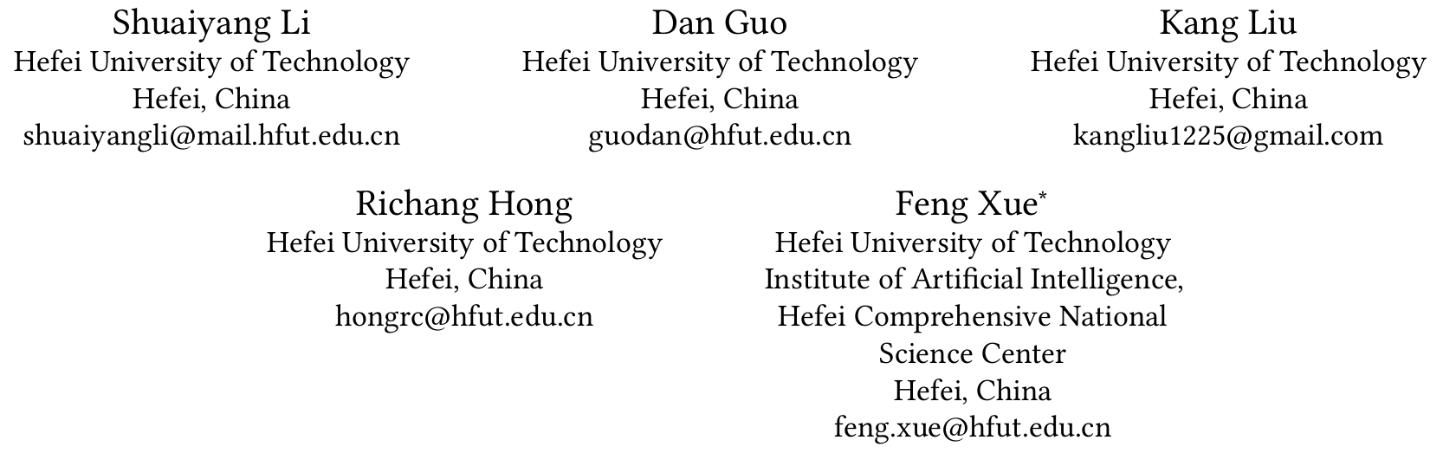





Chongqing University of Technology
ATAI
Advanced Technique of Artificial Intelligence
Chongqing University of Technology
Multimodal Counterfactual Learning Network for Multimedia-based Recommendation
Code：https://github.com/hfutmars/MCLN
—— SIGIR 2023
2024.2.29 • ChongQing
Reported by Peng Shan

Slide 2
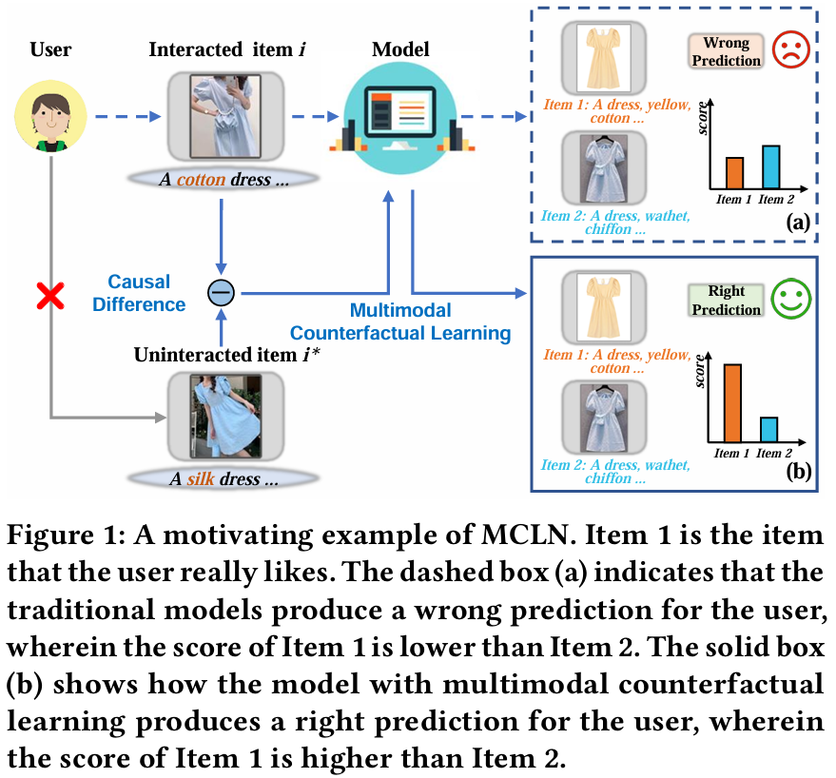
Motivation
（1）existing MMRec models ignore the potential effect of the multimodal content of user-uninteracted items on representation learning.
（2）As a matter of fact, even for a user-interacted item, there is still a small portion of multimodal content that the user dislikes or less likes, which we call user preference-irrelevant multi modal features.

Slide 3
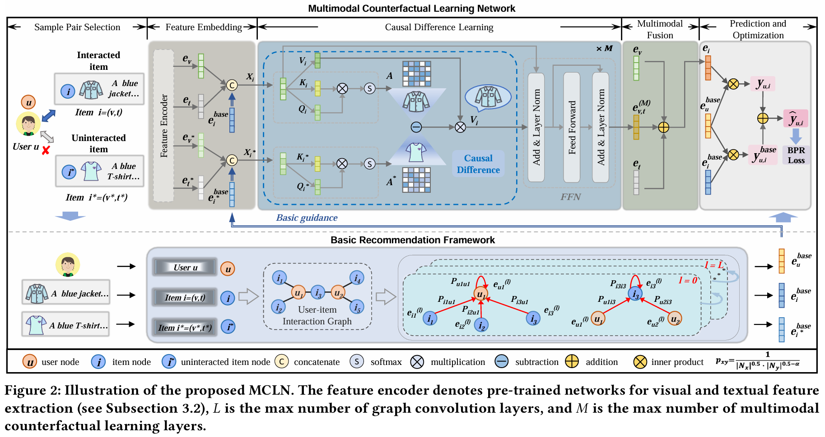
Method

Slide 4
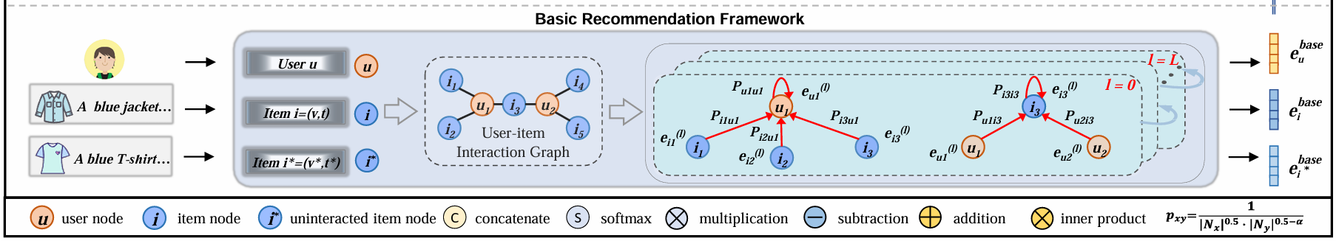

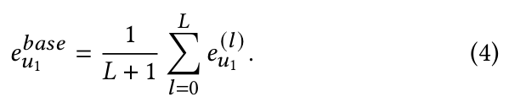

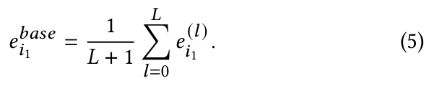
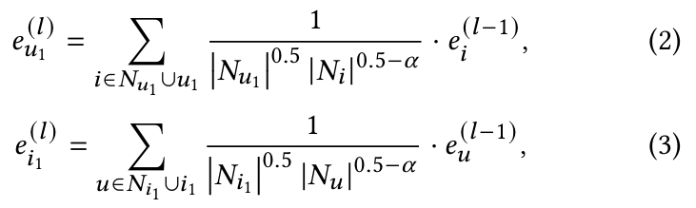
Method

Slide 5
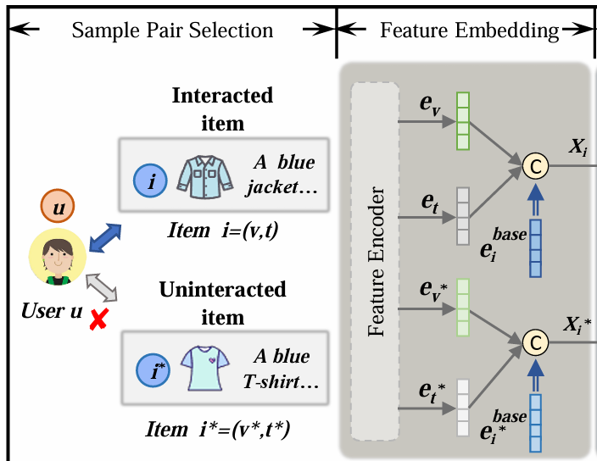
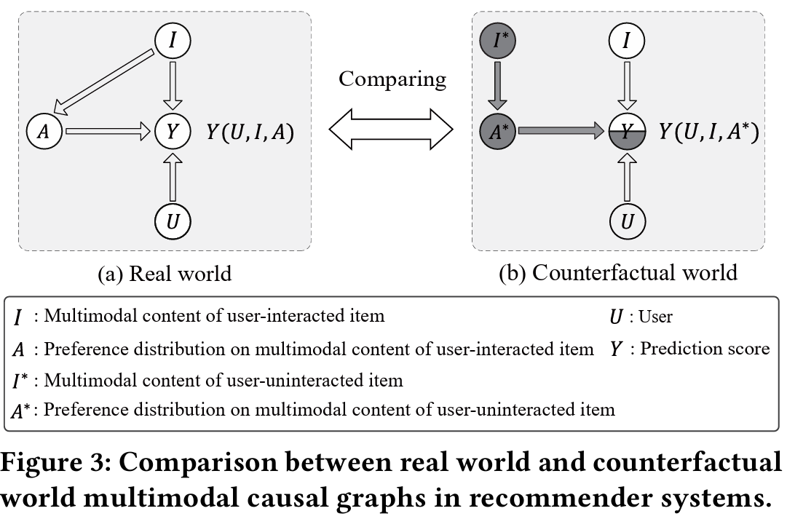


Method

Slide 6
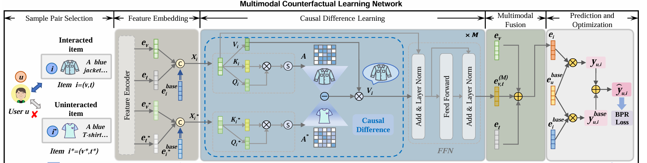
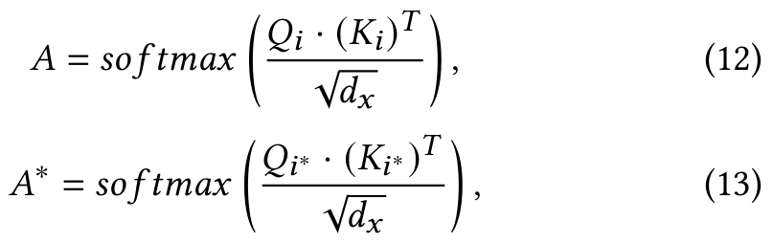
Method

Slide 7

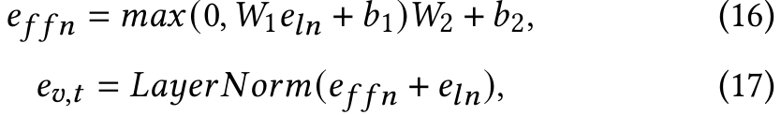
Method

Slide 8
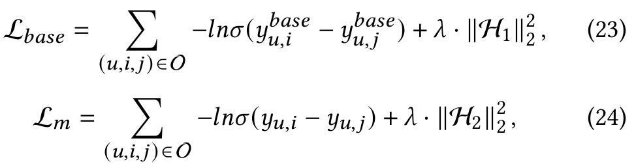
Method

Slide 9
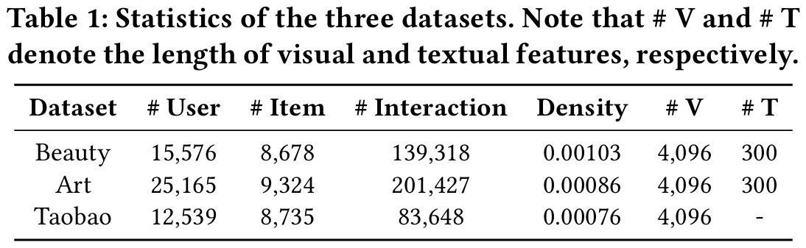
Experiments

Slide 10
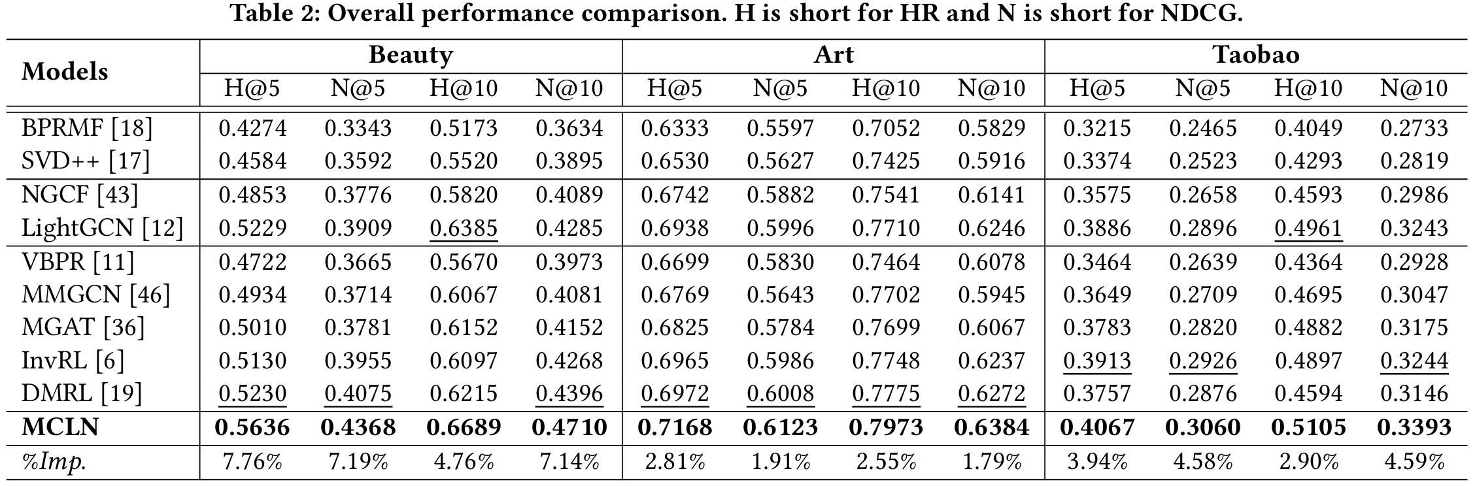
Experiments

Slide 11
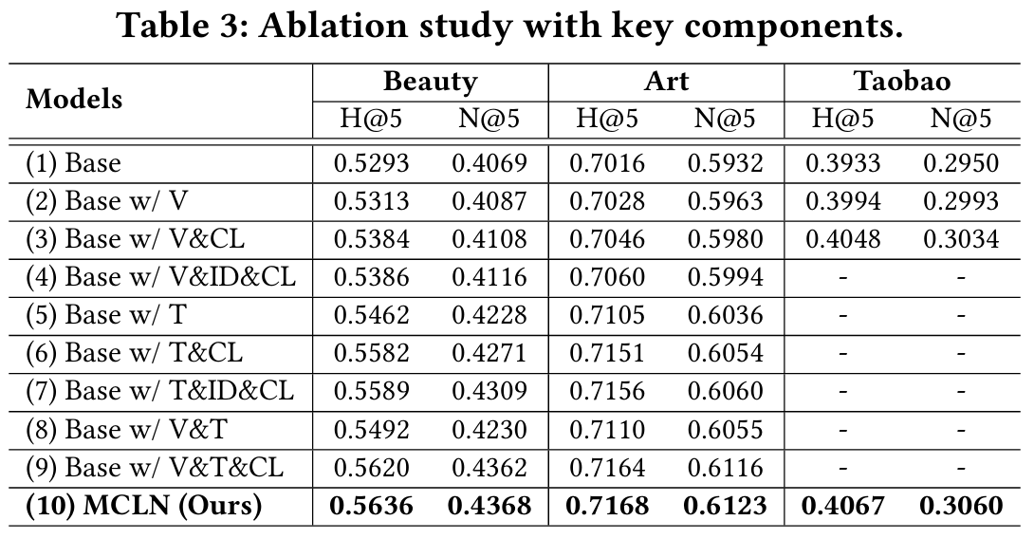
Experiments

Slide 12
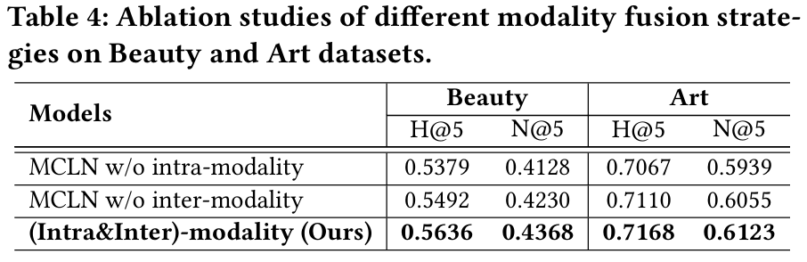
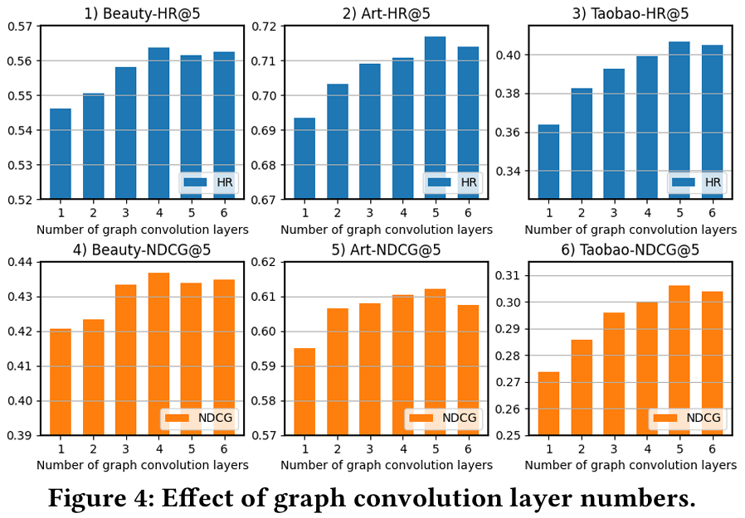
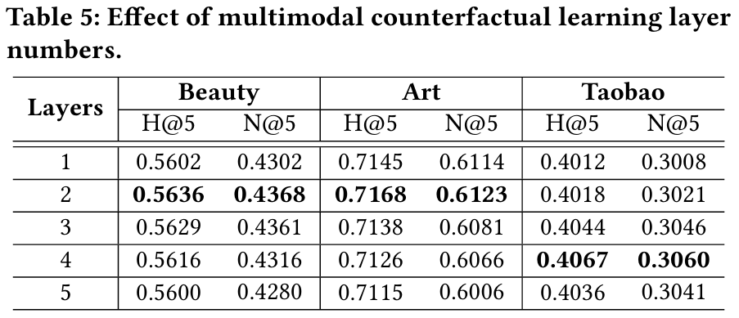
Experiments

Slide 13
Thanks!

